Slide 1
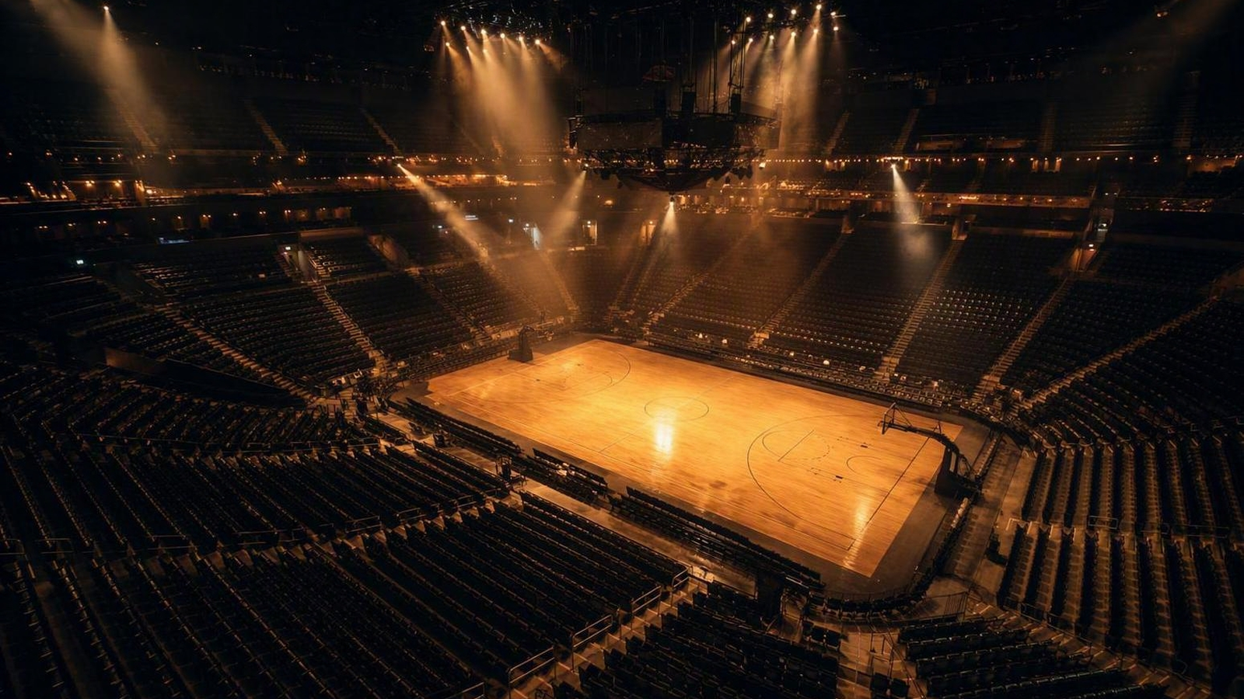

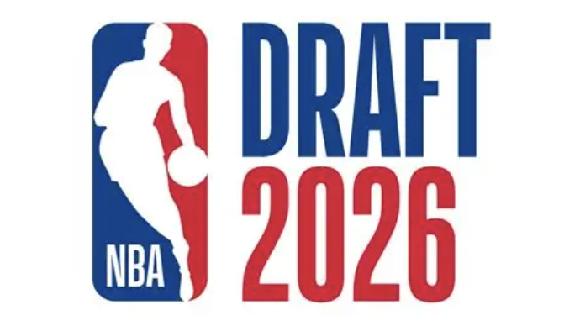
JUNE 23–24, 2026 · BARCLAYS CENTER, BROOKLYN
PREVIEW · PROSPECT BOARD · TEAM FITS
An analytical look at the lottery order, the SPI prospect ratings, projected fits, and where all 30 teams stand heading into draft night.

Slide 2
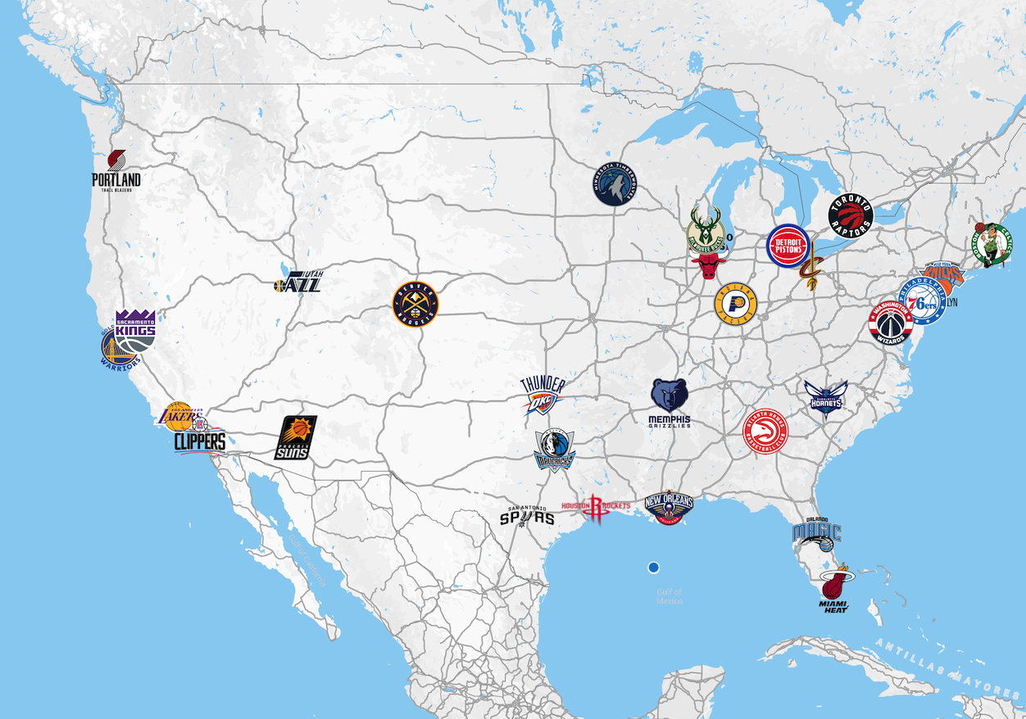
TEAMS
2026 NBA DRAFT PREVIEW
02

Slide 3
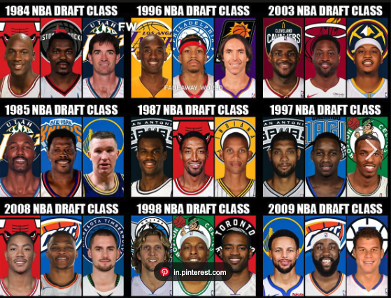
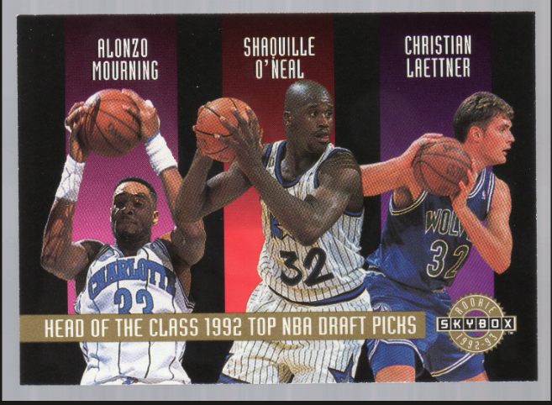
HISTORY
2026 NBA DRAFT PREVIEW
02

Slide 4
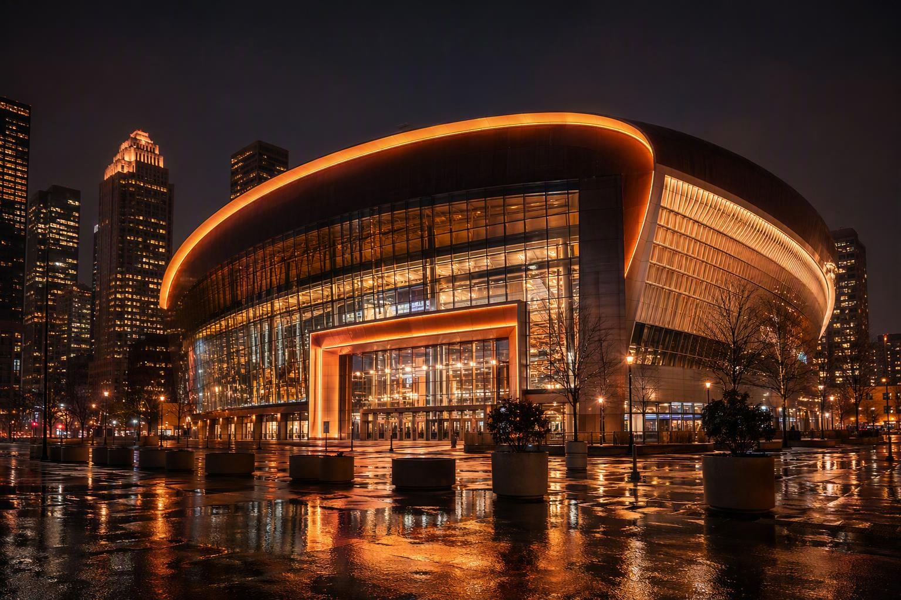
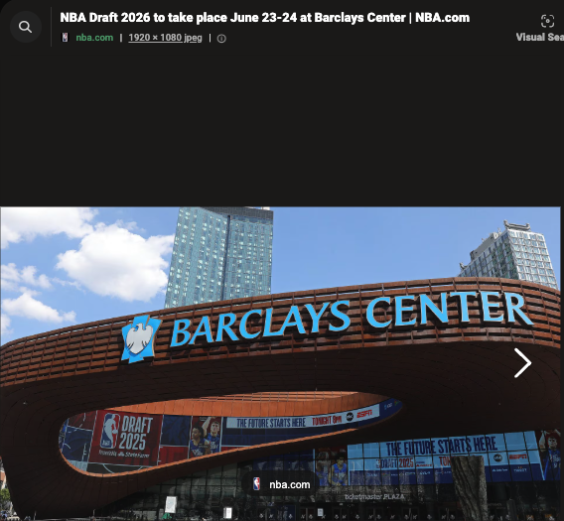
VENUE
2026 NBA DRAFT PREVIEW
02

Slide 5
VENUE
2026 NBA DRAFT PREVIEW
02

Slide 6
DRAFT NIGHT
The 2026 Draft at a Glance
2
8PM
14
#1
ROUNDS, 60 PICKS
ET TIP, BOTH NIGHTS
LOTTERY TEAMS
WASHINGTON WIZARDS
Two-night event across June 23–24
ABC + ESPN (R1) · ESPN (R2)
Top four picks decided by the lottery
Won the May 10 lottery (NBA-worst 17–65)
Format: Barclays Center hosts for a third straight year. First-round picks run on a 5-minute clock; the second round moves to 4 minutes per pick.
2026 NBA DRAFT PREVIEW
02

Slide 7
HOW THE BOARD IS SET
The Flattened-Odds Lottery
Since 2019, the NBA has flattened lottery odds to dull the incentive to tank. The result is a top of the draft that is far less predictable than the old weighted system.
14%
14
4
Top-3 odds, three ways
Teams in the lottery
Picks drawn by lottery
The three worst teams now share identical 14% odds at the No. 1 pick.
Every non-playoff team is entered into the draw for the top selections.
The lottery sets the top four picks; the rest follow reverse standings.
Why it matters: with the worst records no longer guaranteeing the best pick, lottery night carries real swing — and the projected order below assumes no pre-draft trades.
2026 NBA DRAFT PREVIEW
03

Slide 8
DRAFT ORDER · LOTTERY
Picks 1–14
1
Washington Wizards
8
Atlanta Hawks
via NO
2
Utah Jazz
9
Dallas Mavericks
3
Memphis Grizzlies
10
Milwaukee Bucks
4
Chicago Bulls
11
Golden State Warriors
5
LA Clippers
via IND
12
Oklahoma City Thunder
6
Brooklyn Nets
13
Miami Heat
7
Sacramento Kings
14
Charlotte Hornets
2026 NBA DRAFT PREVIEW
04

Slide 9
DRAFT ORDER · ROUND 1
Picks 15–30
15
Chicago Bulls
via POR
23
Atlanta Hawks
via CLE
16
Memphis Grizzlies
via PHX
24
New York Knicks
17
Oklahoma City Thunder
via PHI
25
Los Angeles Lakers
18
Charlotte Hornets
via ORL
26
Denver Nuggets
19
Toronto Raptors
27
Boston Celtics
20
San Antonio Spurs
via ATL
28
Minnesota Timberwolves
via DET
21
Detroit Pistons
via MIN
29
Cleveland Cavaliers
via SA
22
Philadelphia 76ers
via HOU
30
Dallas Mavericks
via OKC
Picks 15–30 follow reverse regular-season order; traded selections noted at right.
2026 NBA DRAFT PREVIEW
05

Slide 10
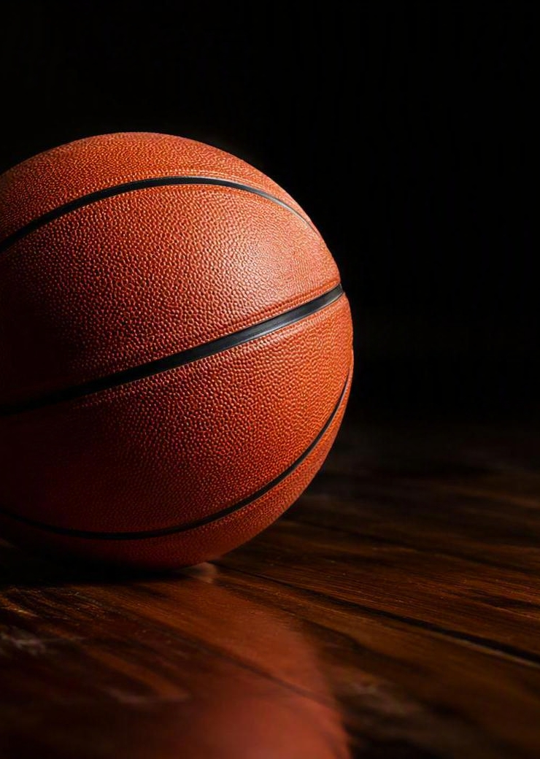
EVALUATING THE CLASS
Scoring Prospects: the SPI
The Success Projection Index is a team-fit-neutral score out of 100 — an overall NBA projection, not a mock-draft slot. Five inputs drive it:
Star upside / ceiling
Translatable NBA skills
Two-way scalability
Role certainty
Risk, variance, health & age curve
SPI BANDS
95–100
90–94
85–89
Franchise cornerstone
Probable star
All-Star path starter
80–84
70–79
65–69
Starter-plus core piece
Rotation / specialist
Fringe / two-way bet
2026 NBA DRAFT PREVIEW
06

Slide 11
THE CLASS, IN FIVE TIERS
From Blue-Chips to Development Bets
TIER 1
Genuine top-end bets
4 names
Dybantsa · Peterson · Boozer · Wilson
TIER 2
Strong top-10 outcomes
7 names
Wagler · Brown · Acuff · Flemings · Ament · Burries · Mara
TIER 3
Strong starter / 1st-round value
11 names
Morez · Lopez · Steinbach · Lendeborg · Anderson · Stirtz …
TIER 4
Real rotation range
Mid 2nd
Okorie through Sharp — one limiting trait apiece
TIER 5
Second-round / two-way bets
Late 2nd
Okpara through Bilodeau — landing-spot dependent
2026 NBA DRAFT PREVIEW
07

Slide 12
TIER 1 · GENUINE TOP-END BETS
The Blue-Chip Four
SPI
SPI
SPI
SPI
96
96
95
92
AJ Dybantsa
Darryn Peterson
Cameron Boozer
Caleb Wilson
FRANCHISE-WING CEILING
PRIMARY-GUARD STAR BET
SAFEST ELITE OUTCOME
MODERN FRONTCOURT STAR
Two-way wing with the highest jumbo-creator upside in the class and a live No. 1 case.
Top-tier shot creation and lead-guard upside — the cleanest backcourt swing on the board.
High-feel, stabilizing frontcourt star — the most bankable floor of any prospect here.
Highest-upside modern forward with real two-way scalability and growth runway.
2026 NBA DRAFT PREVIEW
08

Slide 13
TIER 2 · STRONG TOP-10 OUTCOMES
Star & Near-Star Paths
Real upside remains here — but physical, defensive, or role-certainty questions start to matter more.
89
89
88
88
Keaton Wagler
Mikel Brown Jr.
Darius Acuff Jr.
Kingston Flemings
High-end combo-guard starter upside
Shot-creation + playmaking star path
Lead-guard upside, some variance
Explosive creator with two-way juice
87
86
86
Nate Ament
Brayden Burries
Aday Mara
Long wing-forward ceiling swing
Scoring guard with real upside
Unique skilled-big projection
2026 NBA DRAFT PREVIEW
09

Slide 14
THE BOARD, BY THE NUMBERS
Top 15 SPI Ratings
AJ Dybantsa
96
Darryn Peterson
96
Cameron Boozer
95
Caleb Wilson
92
Keaton Wagler
89
Mikel Brown Jr.
89
Darius Acuff Jr.
88
Kingston Flemings
88
Nate Ament
87
Brayden Burries
86
Aday Mara
86
Morez Johnson Jr.
85
Karim Lopez
85
Hannes Steinbach
85
Yaxel Lendeborg
84
Scale anchored 80–97 to emphasize separation at the top of the board.
2026 NBA DRAFT PREVIEW
10

Slide 15
JUNE 22 MOCK · THE PLAYERS
Projected Board: Top 30
1
AJ Dybantsa
11
Aday Mara
21
Labaron Philon Jr.
2
Darryn Peterson
12
Morez Johnson Jr.
22
Ebuka Okorie
3
Cameron Boozer
13
Karim Lopez
23
Chris Cenac Jr.
4
Caleb Wilson
14
Hannes Steinbach
24
Henri Veesaar
5
Keaton Wagler
15
Yaxel Lendeborg
25
Isaiah Evans
6
Mikel Brown Jr.
16
Christian Anderson
26
Koa Peat
7
Darius Acuff Jr.
17
Bennett Stirtz
27
Jayden Quaintance
8
Kingston Flemings
18
Cameron Carr
28
Meleek Thomas
9
Nate Ament
19
Allen Graves
29
Tarris Reed Jr.
10
Brayden Burries
20
Dailyn Swain
30
Sergio de Larrea
2026 NBA DRAFT PREVIEW
11

Slide 16
MOCK DRAFT · BEST FIT
Projected Lottery Fits: Picks 1–5
1
AJ Dybantsa
League-worst net rating needs a franchise jumbo creator — Dybantsa is the live No. 1.
WIZARDS
2
Darryn Peterson
Utah needs star talent over cosmetic repair; his lead-guard upside is the cleanest swing.
JAZZ
3
Cameron Boozer
A stabilizing, high-feel frontcourt star — the safest elite outcome in the class.
GRIZZLIES
4
Caleb Wilson
Chicago needs direction and frontcourt upside; the highest-ceiling forward left.
BULLS
5
Keaton Wagler
Youth and offensive juice — a shot-making combo guard with starter-level upside.
CLIPPERS
2026 NBA DRAFT PREVIEW
12

Slide 17
WHERE THE LOTTERY PICKS
Team Needs at the Top
TEAM
RECORD
NET
DRAFT FIT
Wizards
17–65
-11.8
Franchise creator / jumbo initiator
Jazz
22–60
-8.2
Rim protector or elite defensive forward
Grizzlies
25–57
-5.9
Stable ballhandler / versatile wing defender
Bulls
31–51
-5.1
Two-way lead guard or large defensive wing
Clippers
42–40
+1.1
Young two-way wing / combo forward
Nets
20–62
-10.3
BPA star upside — lead ballhandler / jumbo creator
Kings
22–60
-10.0
Two-way engine or jumbo wing creator
Hawks
46–36
+2.4
Long, switchable forward who hits open threes
Mavericks
26–56
-5.4
Lead guard / big-wing creator + perimeter stopper
Bucks
32–50
-6.5
Young, explosive perimeter defender / combo wing
2026 NBA DRAFT PREVIEW
13

Slide 18
THE 2025–26 LANDSCAPE
How All 30 Teams Stack Up
TRUE TOP TIER
Thunder · Spurs · Pistons · Celtics · Knicks
Profiles strong enough to call real, not lucky.
GOOD, ONE FLAW
Nuggets · Cavaliers · Rockets · Timberwolves · Lakers · Hornets
A side of the ball lags just enough to expose them.
THE MUSHY MIDDLE
Hawks · Raptors · Heat · Suns · Clippers · Magic · 76ers · Blazers · Warriors
Competent, but not clean enough to scare anyone.
REBUILD TERRITORY
Nets · Wizards · Kings · Jazz · Pacers · Pelicans · Mavericks · Grizzlies · Bulls · Bucks
Different flavors of broken — weak D, thin creation.
2026 NBA DRAFT PREVIEW
14

Slide 19
TWO PATHS TO THE FINALS
Buy a Roster, or Draft One
NEW YORK KNICKS
SAN ANTONIO SPURS
2026 CHAMPIONS · 53–29 · +6.5 NET
WEST CHAMPIONS · 62–20 · +8.3 NET
BUILD MODEL
BUILD MODEL
Free agency + blockbuster trades
Draft-led, with one major trade accelerator
DRAFT IDENTITY
DRAFT IDENTITY
Minimal homegrown stars; mostly acquired talent
Very strong homegrown core
DEFINING MOVE
DEFINING MOVE
Signed Brunson in 2022, then went all-in for OG, Bridges & Towns
Landed Wembanyama at No. 1, nailed Castle & Harper, then traded for Fox
THE LESSON
THE LESSON
You don't have to draft your stars if you identify fit early and spend decisively
Hit on a generational star, don't waste the next two drafts, and the window opens fast
2026 NBA DRAFT PREVIEW
15

Slide 20
WHY THE TOP IS SO HARD
Busts, Steals & Draft Variance
CONSENSUS BUSTS
LATE STEALS & UNDRAFTED
Anthony Bennett — 2013, No. 1
Greg Oden — 2007, No. 1 (over Durant)
Kwame Brown — 2001, No. 1
Michael Olowokandi — 1998, No. 1
Andrea Bargnani — 2006, No. 1
Darko Miličić — 2003, No. 2
Nikola Jokić — No. 41, 2014 (MVP)
Giannis Antetokounmpo — No. 15, 2013
Kawhi Leonard — No. 15, 2011 (2× FMVP)
Jimmy Butler — No. 30, 2011
Ben Wallace — undrafted (HOF)
Fred VanVleet — undrafted champion
THE PATTERN
No. 1 picks are high-variance bets, the top three is where franchises are won or lost, and the real inefficiency lives outside the lottery. The draft is less about picking stars than avoiding catastrophic misses at the top.
2026 NBA DRAFT PREVIEW
16

Slide 21
THE BLUNT READ
How Deep Is This Class?
4
~12–15
AFTER
DEEP
UPSIDE
THAT
The genuine blue-chip tier — Dybantsa, Peterson, Boozer, Wilson.
Where meaningful star or near-star paths still realistically stretch.
Increasingly a choice between certainty and imagination.
“The real blue-chip tier is four deep, the meaningful upside tier stretches to around 12–15, and after that you’re increasingly choosing between certainty and imagination.”
2026 NBA DRAFT PREVIEW
17

Slide 22
THE BOTTOM LINE
What to Watch on Draft Night
01
Washington controls the board
The Wizards hold No. 1 and the clearest path to a franchise creator in Dybantsa.
02
A tale of two builds
Both 2026 finalists reached the top by opposite routes — the Spurs drafted it, the Knicks bought it.
03
Value lives outside the lottery
Jokić, Giannis, and Kawhi are the reminder: the best returns rarely come at the very top.
04
Four blue-chips, then a gamble
Beyond the top four, the class quickly becomes a choice between certainty and upside.
JUNE 23–24, 2026 · BARCLAYS CENTER, BROOKLYN · 8 PM ET

